Slide 1
CPE 301
Lab #6 – The UART Lab

Slide 2
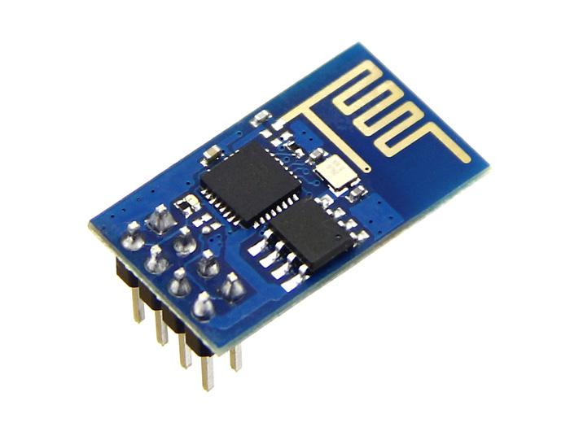
UARTs - Applications
Ubiquitous form of communication between chips, modules, systems
Modules:
Cellular Radios
WiFi Radios
GPS Receivers
IMUs
Modules accept commands via serial, EX: ESP8266 wifi connect command:
“AT+CWJAP =<myWiFiNetwork>,<myWiFiPassword>”

Slide 3
Lab Assignment
Write classical serial functions: U0Init U0kbhit (1 line) U0putChar (2 lines) U0getChar (1 line) | Arduino Equivalents: Serial.begin() Serial.available() Serial.write() Serial.read()
Translate characters to hex Input : ‘a’ Output : “0x61”

Slide 4
UARTs - Process
Transmitting:
Wait for Transmitter Buffer Empty (TBE) Flag
Put byte in data register
Receiving:
If Receive Data Available (RDA) Flag
Return data register

Slide 5
UARTs - Characters
UARTs only send bytes – integers from 0 to 255
Protocol agrees to interpret numbers as characters according to the ASCII code
Procedure:
Read a character
Send back ‘0’, ‘x’
Decode the character and send the appropriate bytes back
Send ‘\n’ for a new line
Example:
Read ‘a’ (ASCII 61)
Send back ‘0’, ‘x’
Send back ‘6’, ‘1’
Send back ‘\n’

Slide 6
Important Pages
Register Summary – 399
Data Register – 218
Control Registers – 219
Baud Rate Register – 222

